Slide 1




AIRPLANE CRASH ANALYSIS WITH POWER BI
Mentorness Internship Presentation By
Matthew Adenyo

Slide 2

Overview
Problem Statement Project Objectives
Data Cleaning Dashboards:
Temporal Analysis
Geospatial Analysis
Trend Analysis
Conclusion
03
04
05
06
06
08
10
12

Slide 3


Problem Statement
This internship project focuses on conducting a comprehensive analysis of airplane crashes and fatalities spanning from 1980 to 2023. The dataset contains crucial information such as crash dates, locations, operators, flight details, aircraft types, and fatality statistics. The goal is to leverage Power BI for interactive visualizations and in-depth insights to understand patterns, contributing factors, and trends in aviation incidents. The analysis aims to provide stakeholders with valuable information for enhancing aviation safety and mitigating risks.
3

Slide 4

Project Objectives
Temporal Analysis:
Explore temporal trends in airplane crashes over the years.
Identify patterns in the frequency and severity of incidents.
Geospatial Analysis:
Visualize crash locations on a map to identify hotspots.
Analyze the distribution of incidents across different regions.
Operator Performance:
Evaluate the safety records of different operators and airlines.
Identify operators with higher incident rates.
Aircraft Analysis:
Analyze the involvement of specific aircraft types in incidents.
Examine the relationship between aircraft registration and crash occurrences.
Fatality Trends:
Explore trends in passenger and crew fatalities.
Investigate factors contributing to fatalities.
Route Analysis:
Analyze incident patterns on specific flight routes.
Identify routes with a higher likelihood of incidents.
4

Slide 5
Data Cleaning
The data cleaning involved addressing missing values, standardizing formats, and ensuring data accuracy and consistency.
Three new columns Year, Country, and City were added to enhance the dataset's analytical depth. The Year column contains the year of the incident derived from the date of incident. The Country column specifies the country where each incident occurred while the City column specifies the cities where the incident occurred. Furthermore, aircraft with blank registration details were assigned “No Registration”.
All these processes ensure that the dataset is well-prepared for accurate analysis and informed decision-making in the aviation industry.
5

Slide 6
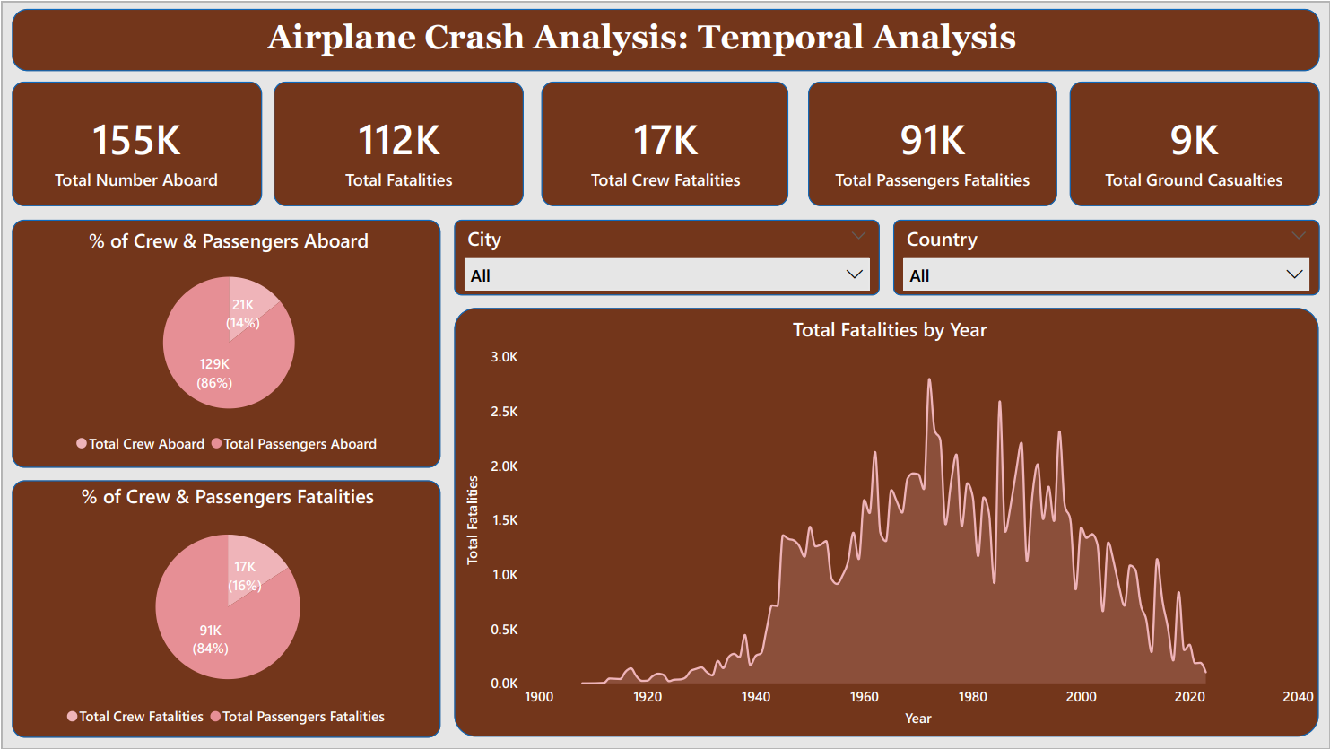

Slide 7

The Temporal analysis revealed fluctuations in the frequency of airplane crashes over the years with notable spikes and declines observed. That is, 1972 records the highest number of total fatalities (2,796) while 1908 and 1909 records the lowest fatality (1).
In addition, the distribution of crew and passengers aboard were revealed as 14% and 84% respectively.
The analysis also revealed 16% crew fatalities and 84% passenger fatalities, providing a deeper understanding of the distribution of fatalities within the aircraft.
7

Slide 8
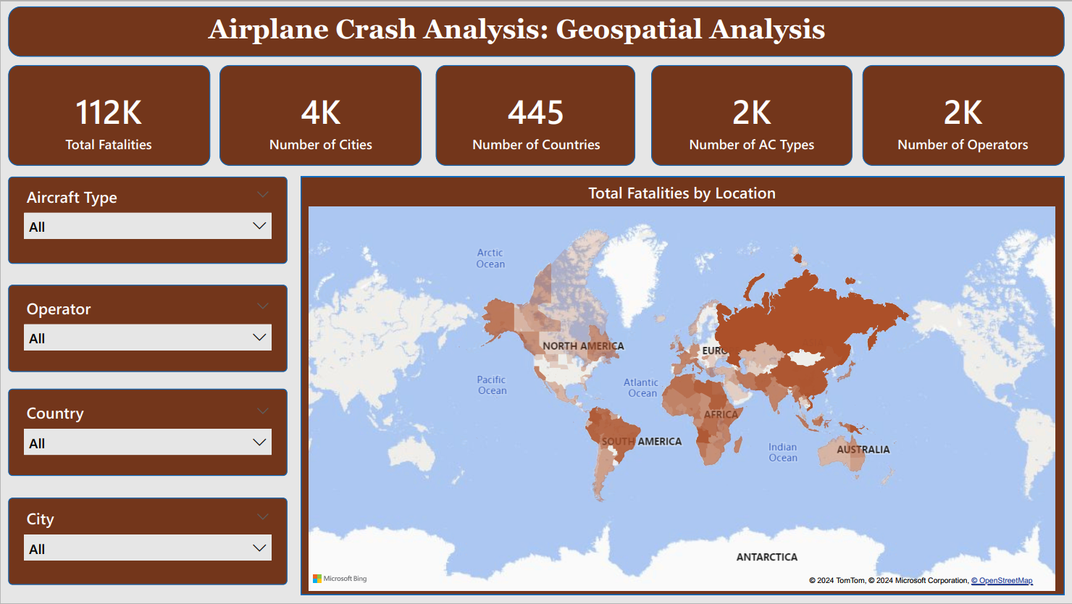

Slide 9
Through the visualization of crash locations on a world map, hotspots of incidents were identified. This will enable stakeholders to focus their attention on regions with higher incident rates.
By using Power BI interactive tools, the aircraft type and operator with the highest incident at a specific location can also be identified.
9

Slide 10
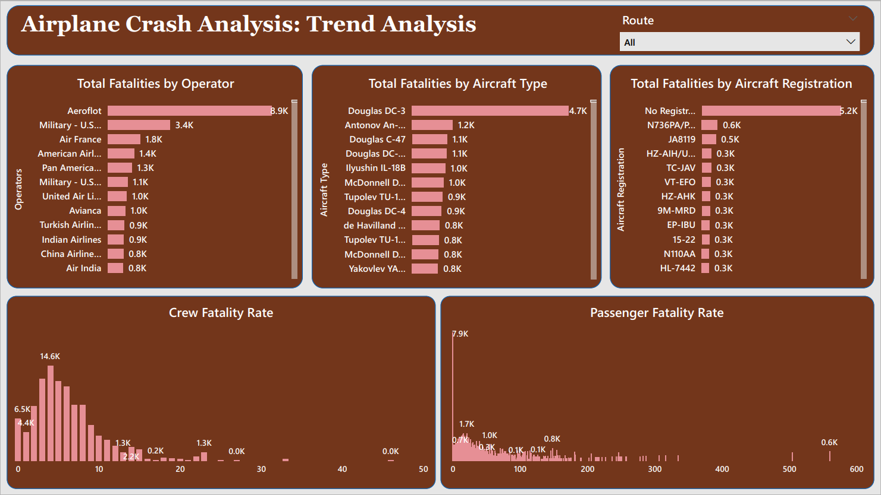

Slide 11
Flight routes analysis revealed insights into routes with a higher likelihood of incidents. This will help stakeholders make informed decisions regarding route planning.
By analyzing the total fatality by operator and aircraft type, operators and aircraft types with the highest record of fatalities were identified.
Exploring the trends in passenger and crew fatalities revealed the rate of crew and passenger fatality. This gives stakeholders insight into fatality distribution for each incident helping in deriving safety measures to combat it.
11

Slide 12
Conclusion
The comprehensive analysis of the airplane crash data from 1980 to 2023 has provided valuable insights into the patterns, contributing factors and trends in aviation incidents. With the utilization of Power BI for interactive visualizations and in-depth exploration of the dataset, significant findings have emerged. These findings shed light on historical occurrences and offer actionable information for stakeholders to enhance aviation safety and mitigate risks effectively.
That is, by understanding the dynamics of past incidents, stakeholders can make informed decisions to improve safety protocols, operational procedures and regulatory measures to foster a safer environment for air travel.
12

Slide 13


Thank You!
Gerente General

